Slide 1
Predicting Landing Times and Initial Velocities For a Lander in a Two-Body System
Carl De Vries
Spring 2014
C++

Slide 2
Parameter Study
Set up the model.
Validate the case study.
Gather parameter study data.
Share results and analysis.
Notes:
1. Understand why numerical integrators are good for modeling problems, specifically aerospace problems.
2. Validation of initial case study is important to:
prove RK4 works
also gives us base values to compare against

Slide 3







Systems of Equations: Physics
Position:
r$(t)$
for
$$\text{r}\left(t\right)=x_{0}$$
$$\frac{d\text{r}}{dt}=v(t)$$
Velocity:
for
$$v\left(t\right)=v_{0}$$
Acceleration:
$$\frac{d^{2}\text{r}}{dt^{2}}=\frac{dv }{dt}=a(t)$$
General Euler Equation:
$$y_{i+1 }= y_{i}+F\left(x_{i}, y_{i}\right)h$$
Position Euler Equation:
$$r_{1}= r_{0}+v(t)× h$$
Notes:
General Application

Slide 4
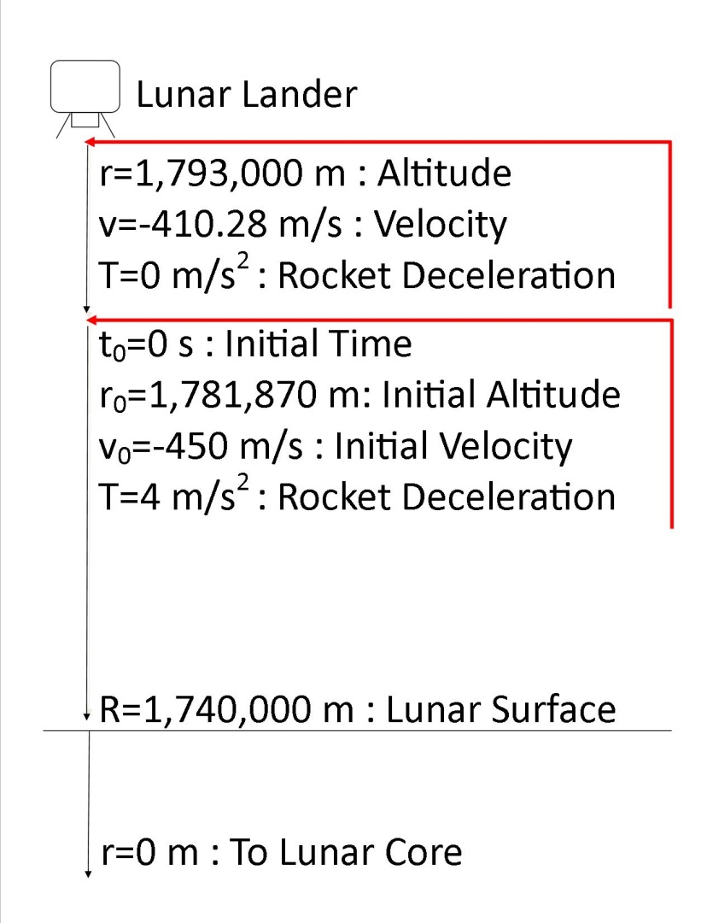



Case Study: Lunar Lander
Diagram:
The Differential Equation:
$$F=ma=\frac{GMm}{r^{2}}$$
$$a=\frac{GM}{r^{2}}$$
$$a(t)=T−\frac{GM}{r^{2}}$$
Note:
The lander’s altitude [r] is measured from the center of the moon.
To calculate initial conditions
Use a chain rule substitution.
Integrate using separation of variables.
Evaluate at T=0 and T=4.
Set the equations equal and solve.
Notes:
1. Differential Equations & Boundary Value Problems: Computing and Modeling by Henry Edwards and David Penney
2. The lander is heading straight down towards the lunar surface and is at r with v and T
At some point along the decent, the retrorockets will ignite at 4m/s2
How long after ignition until the lander safely lands? What conditions need to be met? R=1,740,000 and v = 0
What we need to know? V0 and r0 at t=0
Using Newton’s 2nd Law
We want the acceleration of the lander, so F is the force acting on the lander, and (little) m is the mass of the lander
Newton’s Law of Gravitation
Gives the force of attraction between two point masses, (little) m is the mass of the lander

Slide 5







System of Equations: Lunar Lander
Altitude:
$$r=x(t)$$
for
$x\left(0\right)=1,781,870$ m
Velocity:
$$\frac{dr_{1}}{dt}=v(t)$$
$$v\left(0\right)=−450 m/s$$
for
Acceleration:
$$\frac{dr_{2}}{dt}=T−\frac{GM}{x^{2}}$$
General Euler Equation:
$$y_{i+1 } = y_{i}+ F\left(x_{i}, y_{i}\right)h$$
Position Euler Equation:
$$r_{1}=1,781,870+(−450)h$$

Slide 6
Case Study Values
Constants
Deceleration from thrust: T = 4 m/s²
Gravitational constant : G = 6.6726 x 10⁻¹¹ N*m²/kg²
Lunar mass: M = 7.35 x 10²² kg
Lunar radius: R = 1,740,000 m
Inputs
Initial time value: x₀ = 0 s
Initial altitude value: y₀[0] = 1,781,870 m
Initial velocity value: y₀[1] = -450 m/s
Upper limit of integration: x_{n} = 200 s
Number of steps: n = 200
Calculations
Step size: h = 1 s
Notes:
1. We are starting at ignition. T will equal 4 from here on.
2. Input variables are matched with the variables in the code.
3. The square brackets indicate a one dimensional array. Think a single column in an Excel workbook.
4. The xn and n values of 200 is given. They give us a nice step size of one second

Slide 7
Case Study Results
Step | Time | Case Study Altitude | Simulation Altitude | Case Study Velocity | Simulation Velocity
180 | 180 | 1740059 | 1740059 | -16.83 | -16.83
181 | 181 | 1740044 | 1740043 | -14.45 | -14.45
182 | 182 | 1740030 | 1740030 | -12.07 | -12.07
183 | 183 | 1740019 | 1740019 | -9.69 | -9.69
184 | 184 | 1740011 | 1740011 | -7.31 | -7.31
185 | 185 | 1740005 | 1740005 | -4.93 | -4.93
186 | 186 | 1740001 | 1740001 | -2.55 | -2.55
187 | 187 | 1740000 | 1740000 | -0.17 | -0.17
188 | 188 | 1740001 | 1740001 | 2.21 | 2.21
189 | 189 | 1740004 | 1740004 | 4.59 | 4.59
190 | 190 | 1740010 | 1740010 | 6.97 | 6.97
Notes:
1. The table and graphs show the data with a shrunken domain.
2. The time to land is 187 seconds
3. The altitude is perfect, but the velocity is just with a tolerance picked by the authors.
4. The altitude at t=181 is off by 1, considered it a rounding error.

Slide 8
Parameter Study
Fixed retro-rocket ignition altitude
Independent variable:
Acceleration from Thrust
Domain 3.5≤T≤4.5
Steps size: 0.05
Dependent variables:
Landing Time
Starting velocity at fixed ignition point
Tolerances: r = ± 5m and v = ±1m/s
Notes:
1. Tolerances are needed because extremely small time steps (large n) would be needed to get answers that are dead on.
2. Tolerances for landing values
All landing velocities are 0.25% or less of the initial velocity
All landing altitudes are 0.00028% or less of the initial fixe altitude

Slide 9
Landing Solutions
Thrust (T) | Time (t) | Start Velocity (v₀)
3.5 | 210 | -400.8
3.55 | 208 | -406
3.6 | 205 | -411.12
3.65 | 202 | -416.18
3.7 | 200 | -421.18
3.75 | 198 | -426.1
3.8 | 195 | -431
3.85 | 193 | -435.8
3.9 | 191 | -440.6
3.95 | 189 | -445.3
4 | 187 | -450
4.05 | 185 | -454.6
4.1 | 183 | -459.2
4.15 | 181 | -463.72
4.2 | 180 | -468.26
4.25 | 178 | -472.66
4.3 | 176 | -477.1
4.35 | 175 | -481.44
4.4 | 173 | -485.8
4.45 | 172 | -490.1
4.5 | 170 | -494.31
Notes:
Go back to slide 7.
2. As thrust and velocity increase the Avt graph will become much steeper (more compact in the t direction).
NetAccel= 4-1.5=2.5 and 4-1.6=2.4
3. Analytical IVP problems yield y= f(x)+c where we can just plug in x values and get the y values.
Is it possible to use numerically calculated points and apply a curve fit so that we can retrieve y values from a simple y=f(x) function

Slide 10
Interpolation
Thrust | Estimated Time | Estimated Velocity | Numerical Time | Numerical Velocity | % Diff. Time | % Diff. Velocity
3.57 | 206.478168 | -408.0588507 | 207 | -408.05 | 0.25% | 0.00%
3.77 | 196.777928 | -428.0031815 | 197 | -428.08 | 0.11% | 0.02%
3.97 | 188.143288 | -447.1745603 | 188 | -447.22 | 0.08% | 0.01%
4.03 | 185.760688 | -452.7752483 | 186 | -452.76 | 0.13% | 0.00%
4.23 | 178.511328 | -470.9417895 | 179 | -470.89 | 0.27% | 0.01%
4.43 | 172.327568 | -488.3353787 | 172 | -488.35 | 0.19% | 0.00%
Notes:
1. All interpolations are well within a good percent difference of the numerical value.
2. The %diff values have show no real correlation.
3. The shifting may be cause by some values being almost exactly zero, other may have been barely acceptable.

Slide 11
Extrapolation
Thrust | Estimated Time | Estimated Velocity | Numerical Time | Numerical Velocity | % Difference Time | % Difference Velocity
5.5 | 157.35 | -568.26 | 147 | -572.78 | 7.04% | 0.79%
5.25 | 158.12 | -551.57 | 152 | -554.2 | 4.03% | 0.47%
5 | 160.55 | -533.67 | 157 | -535.98 | 2.26% | 0.43%
4.75 | 164.65 | -514.56 | 163 | -515.05 | 1.01% | 0.10%
3.25 | 224.22 | -374.54 | 226 | -373.78 | 0.79% | 0.20%
3 | 239.97 | -346.98 | 245 | -344.63 | 2.05% | 0.68%
2.75 | 257.39 | -318.21 | 270 | -312.78 | 4.67% | 1.74%
2.5 | 276.48 | -288.23 | 306 | -277.3 | 9.65% | 3.94%
Notes:
1. %percent differences for IVvAT are much better than LTvDT, but we won’t have a reliable approximation for landing time.
2. Extrapolations have much larger intervals leading to what looks like larger % differences
3. The shifting may be cause by some values being almost exactly zero, other may have been barely acceptable.

Slide 12

Summary
The quadratic curve is reliable for interpolation and close extrapolations.
Changes to best-fit curve
Interpolation shows no change.
A cubic best-fit curve increases accuracy for extrapolation within short increments of the data set.
Higher order polynomials decrease the reliability of extrapolations.
Power curve fit improves extrapolations for Landing Time vs. Deceleration from Thrust.
$t=600.14x^{−0.84}$
Logarithmic curve fit improves extrapolations for Initial Velocity vs. Deceleration from Thrust.
$v=−372\ln\left(x\right)+75.565$
Notes:
1. Higher order polynomials 4-6 are bad because of changes in concavity.
2. The power curve fit improves the extrapolations for landing time out to about 6
3. Logarithmic curve fit improves extrapolations for initial velocity out a long ways.
4. NO DEFINITIVE DATA SETS
5. The data sets don’t necessarily need to have the same curve fit

